Slide 1
Variables and Data Types
Chapter 2

Slide 2
Program and Data
In every program there are three main elements we need to identify:
Input: Data to be processed.
Output: The expected result.
Look for nouns in the problem statement that suggest output
and input.
processing: The statements to achieve.
Look for verbs to suggest processing steps.
input data
output data
Keyboard
Mouse
Processing
Screen
Printer

Slide 3
Program and Data: Example
Write a program to read 2 numbers and print their sum
Input: 2 numbers: first number , second number
Process
  Add two numbers (+)
  Print their sum
Output: Sum of two numbers

Slide 4
Program and Data
First, we will focus on the input data
input data
output data
Keyboard
Processing
Screen

Slide 5
Identifiers: variables and constants
Identifiers: names of things that appear in programs, such as variables and constants
Rules for naming C++ identifiers:
  It can consist of letters (A-Z and a-z), digits (0-9), and the underscore character _
  No other symbols are allowed
  It should begin with a letter or underscore
  It should not begin with a number
  It should not be a reserved word (keyword): ex. int, float, double, char, const, void, return

Slide 6
Identifiers: variables and constants
C++ is case sensitive: uppercase and lowercase letters are considered different
Example: the identifier NUMBER is not the same as the identifier number

Slide 7
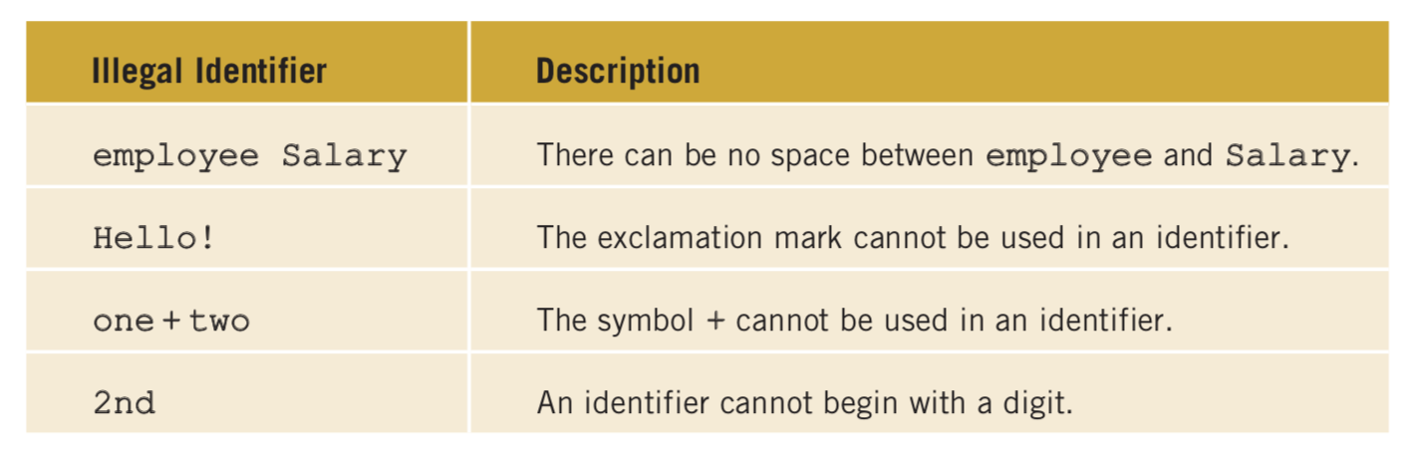
Identifiers: variables and constants
Examples of legal identifiers:
  Name
  X1
  _count
  first_num
Examples of illegal identifiers:

Slide 8
Variables
Variable: A memory location whose content may change during program execution
Data must be stored into main memory before it can be used
This is done in two steps:
  Give a name to the memory location
  Identify the type of data to store in this memory location
This is called variable declaration
Name identifier
Select data type
Assign value
Use variable

Slide 9
Standard data types
Data Type | Represents | Operations | Examples
int | Integer values in the range | Add, Subtract, Multiply, Divide, Find reminder, and Compare | -6728, -67, 0, 78, 36782, +763
float | Decimal numbers that include a decimal point | Add, Subtract, Multiply, Divide and Compare | 75.924, 0.18, -1.482, 7800.0
char | It is mainly used to represent characters (letters, digits, and special symbols). These are enclosed with a single quotes ‘’ inside the code. | Compare | 'A', 'a', '9', '*', '+', '$', '&', ' '
bool | Logical (Boolean) values | Logical operations | true, false

Slide 10
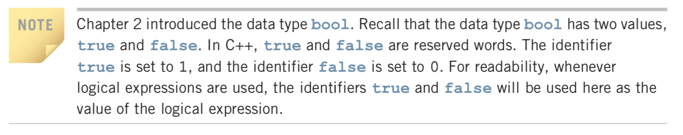
Boolean data type

Slide 11
String data type
String: a sequence of zero or more characters
It is a programmer-defined data type, i.e. not directly available for use in a program like the simple data types (int, float, char, bool)
enclosed in double quotation marks “”
Null or empty string: A string containing no characters
Examples of strings:
  “C++”
  ”Hello World”
  “15”
  “”
There are many operations to manipulate strings (will be discussed later)

Slide 12
Variable declaration
When a variable is declared, memory is allocated for it
Syntax for declaring a variable:
DataType IdentifierName;
Example:
  int num;
  bool done;
  char ch;
* Remember, each line in C++ should end with ;
You must declare all identifiers before you can use them. If you use an identifier without declaring it, the compiler will generate a syntax error.

Slide 13
Variable declaration
If we need to declare several variables of the same type, we separate them using ,
Example:
int first;
int second;
Can be written as:
int first, second;

Slide 14
Variable initialization
You should assign a value to the variable before using it
Using a variable in an expression without initializing it produces erroneous results
Initializing variables could be done in two ways:
  Using the assignment statement (assign a value to a variable)
  Reading the value from a standard input device (explained later)
Syntax for using the assignment statement
variableName = value;
The value should be compatible with the data type

Slide 15
Variable initialization
We can declare and initialize variables at the same time
Example:
  int age = 20;
  float x = 5.5, y = 10.0;
  char ch1, ch2 = ‘A’;

Slide 16
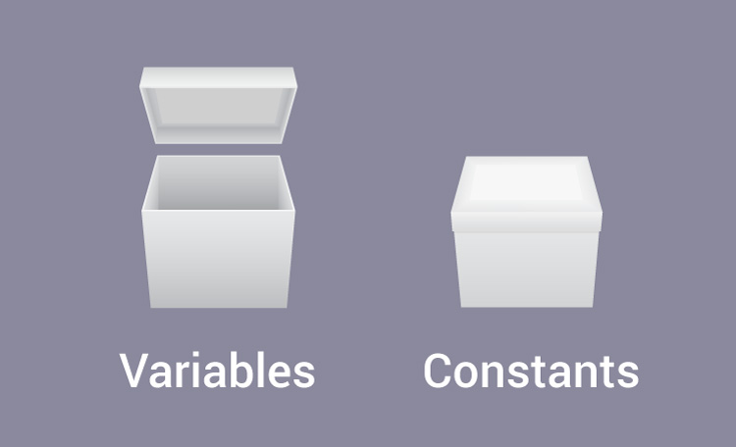
Constants
Two types of data that could be used in a program
  Data that can be changed → variables
  Data that can’t be changed → constants

Slide 17
Constants
Constant: Memory location whose content is not allowed to change during program execution
Syntax to declare a named constant:
const dataType identifierName = value;
const is keyword
    const float PI = 3.14;
Programmers typically prefer to use uppercase letters to name a constant

